Slide 1



When Satellite is All You Have: Watching the Internet from 550 ms
Daniel Perdices; Gianluca Perna; Martino Trevisan; Danilo Giordano; Marco Mellia
24 April 2024
Perdices, D., Perna, G., Trevisan, M., Giordano, D., & Mellia, M. When satellite is all you have: watching the internet from 550 ms. In Proceedings of the 22nd ACM Internet Measurement Conference. Doi: 10.1145/3517745.3561432

Slide 2
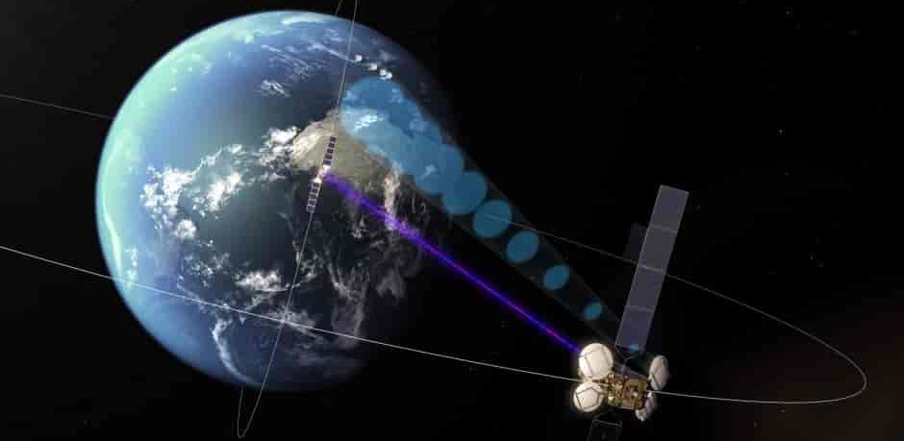
Satellite Communication (SatCom) in a Nutshell
Customers connect via a GEO (Geostationary Earth Orbit) satellite network
More than 36.000 km from Earth
More than 550 ms RTT for Internet access
Equipped with multiple directional antennas
Each manages a transmission beam aimed at to a specific region on the earth
Customers connect to the SatCom network via customer-premises equipment (CPE)
manages link and access protocols
acts as a Performance Enhancing Proxy (PEP)
sends data via the satellite to the ground station using a UDP tunnel (L4 Proxy)
The Ground Station on the provider-premises receive the customer’s data traffic
uses a PEP to break the connection and access the Internet
36.000 km
> 550 ms RTT

Slide 3
Satellite Communication (SatCom) in a Nutshell
Customers connect via a GEO (Geostationary Earth Orbit) satellite network
More than 36.000 km from Earth
More than 550 ms RTT for Internet access
Equipped with multiple directional antennas
Each manages a transmission beam aimed at to a specific region on the earth
Customers connect to the SatCom network via customer-premises equipment (CPE)
manages link and access protocols
acts as a Performance Enhancing Proxy (PEP)
sends data via the satellite to the ground station using a UDP tunnel (L4 Proxy)
The Ground Station on the provider-premises receive the customer’s data traffic
uses a PEP to break the connection and access the Internet
36.000 km
> 550 ms RTT
SatCom breaks TCP connections to speed-up the communication
Customer-premises SatCom equipment impersonates the the destination server by
Breaking 3-way handshake ➔ Send data with no delay
Buffering TCP data and send it to the ground-station ➔ uplink speed
Ground station establishes a new TCP connection with the actual destination server
Speed regulated by the download rate of the customer device ➔ Preserve PEP buffer
Work as Network Address Translation (NAT) box, DNS resolver*, and Quality of Service (QoS) schedulers
*default but customer may change it

Slide 4
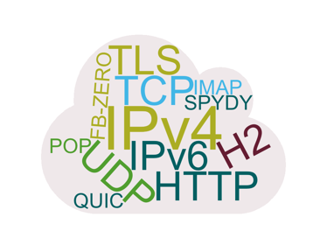

The Questions
How does customers’ traffic look like?
How much does customers consume?
What customers consume?
Which performance customers get?

Slide 5
Measurement Setup
February – April 2022
34.4 Billions flows
4.3 PB of client traffic
Process traffic in real-time
100+ statistics computed at the end of the flow
Implements DN-Hunter
To Track DNS conversations
To tag the network flows with the FQDN
Tens k customers
20 countries Max 5 Mbit/s Up Up to 100 Mbit/s Down
c_ip | c_port | c_pkts | c_bytes | s_ip | s_port | s_pkts | s_bytes | Protocol
12.132.54.94* | 1197 | 1 | 18938 | 87.250.137.92 | 443 | 1 | 992221 | HTTP
FQDN
Facebook.com
TLS/SNI
Facebook.com
5
*Client IP address is anonymized
Tstat
DN-Hunter

Slide 6
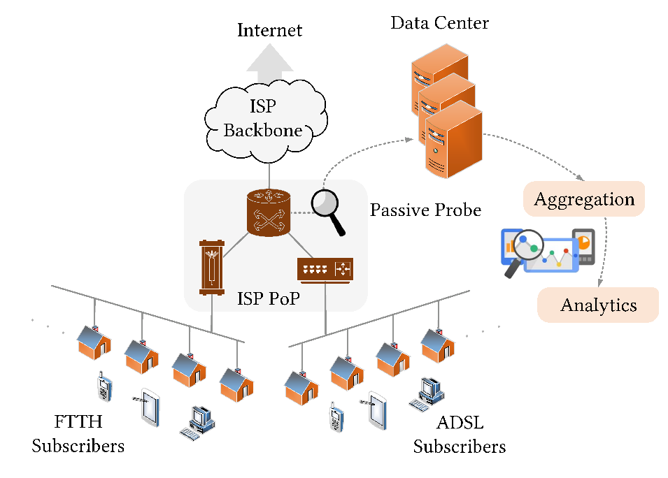
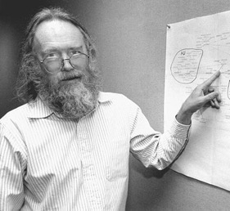
Measurement Setup
February – April 2022
34.4 Billions flows
4.3 PB of client traffic
Process traffic in real-time
100+ statistics computed at the end of the flow
Implements DN-Hunter
To Track DNS conversations
To tag the network flows with the FQDN
“A name indicates what we seek.
An address indicates where it is.
A route indicates how we get there.”
When | FQDN
Current | facebook.com, fbcdn.com
Before | fbstatic-a.akamaihd.net
Jon Postel – RFC 791
Regexp* | Service
facebook.com, fbcdn.com, ˆfbstatic-[a-z].akamaihd.net$ | Facebook
netflix.com, nflxvideo.net | Netflix
Tens k customers
20 countries Max 5 Mbit/s Up Up to 100 Mbit/s Down
*Full list at https://dl.acm.org/doi/10.1145/3517745.3561432
c_ip | c_port | c_pkts | c_bytes | s_ip | s_port | s_pkts | s_bytes | Protocol
12.132.54.94* | 1197 | 1 | 18938 | 87.250.137.92 | 443 | 1 | 992221 | HTTP
FQDN
Facebook.com
TLS/SNI
Facebook.com
6
*Client IP address is anonymized
Tstat
DN-Hunter

Slide 7
How does customers’ traffic look like?

Slide 8
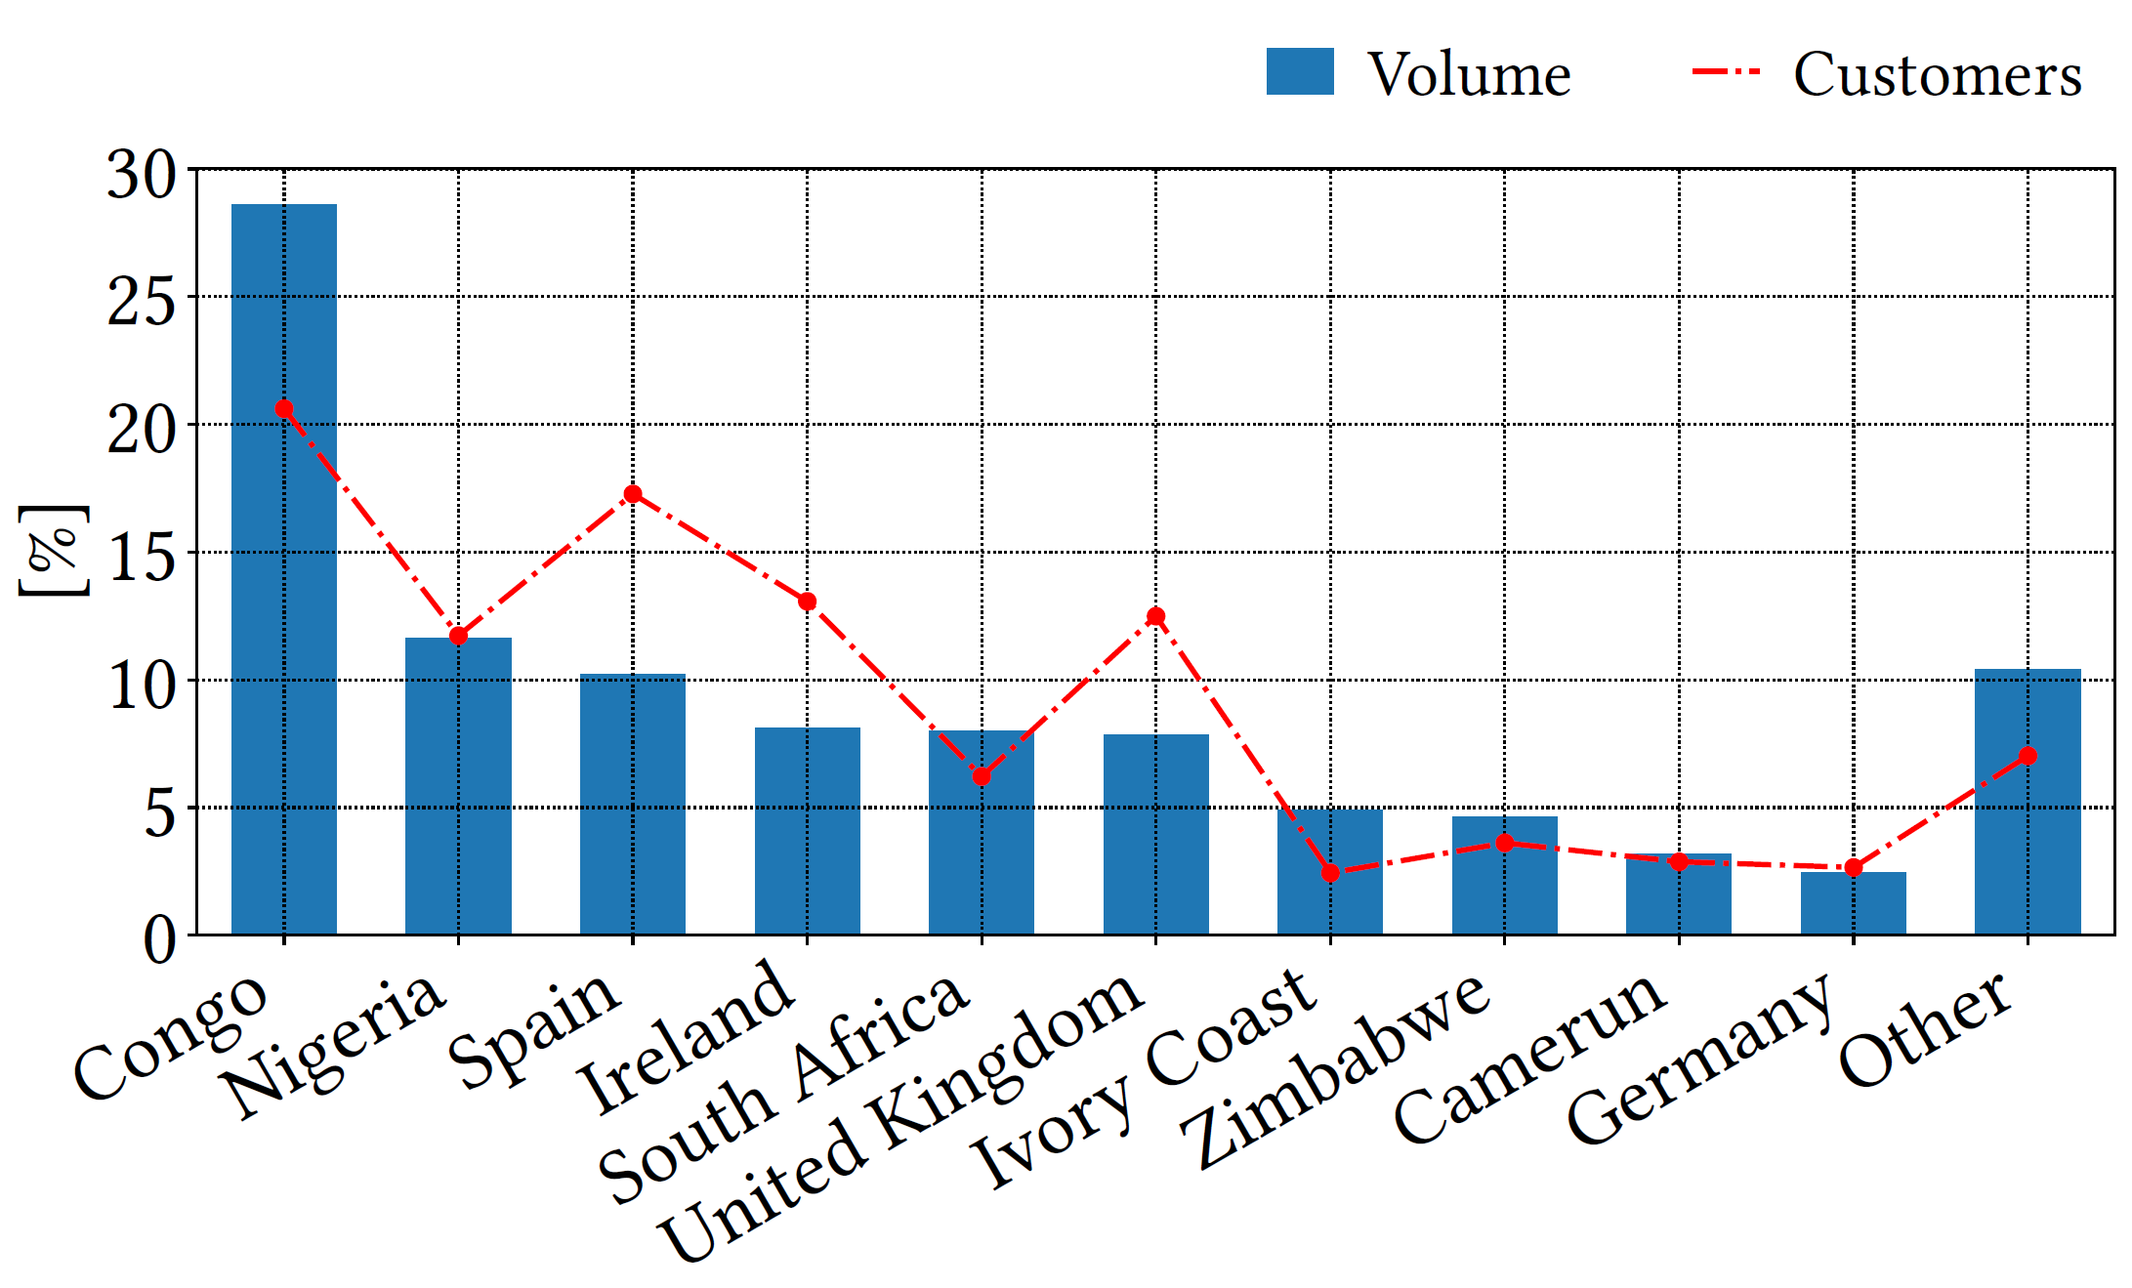
Customers country and aggregate volume
% of total volume and customers per country
African countries have high number of customers and high volume per customer
Approximately 600 MB/day
European countries with high number of clients but low volume per customer
Approximately 170 MB/day
African countries may share the connection with several end-users
European countries only use it when they are forced to do so

Slide 9
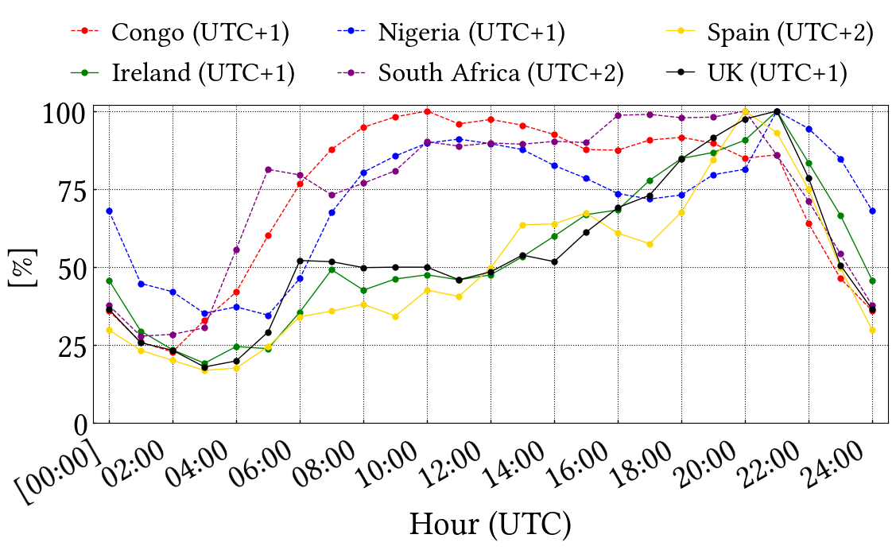
How daily pattern looks like?
% of volume per hour w.r.t. peak time
All aligned to UTC – different only for Spain and South Africa
Clear daily patterns, but differences between continents
High usage during daylight hours in Africa, low usage in Europe
Peak time for both peak time is around 20-21

Slide 10
How much does customers consume?

Slide 11
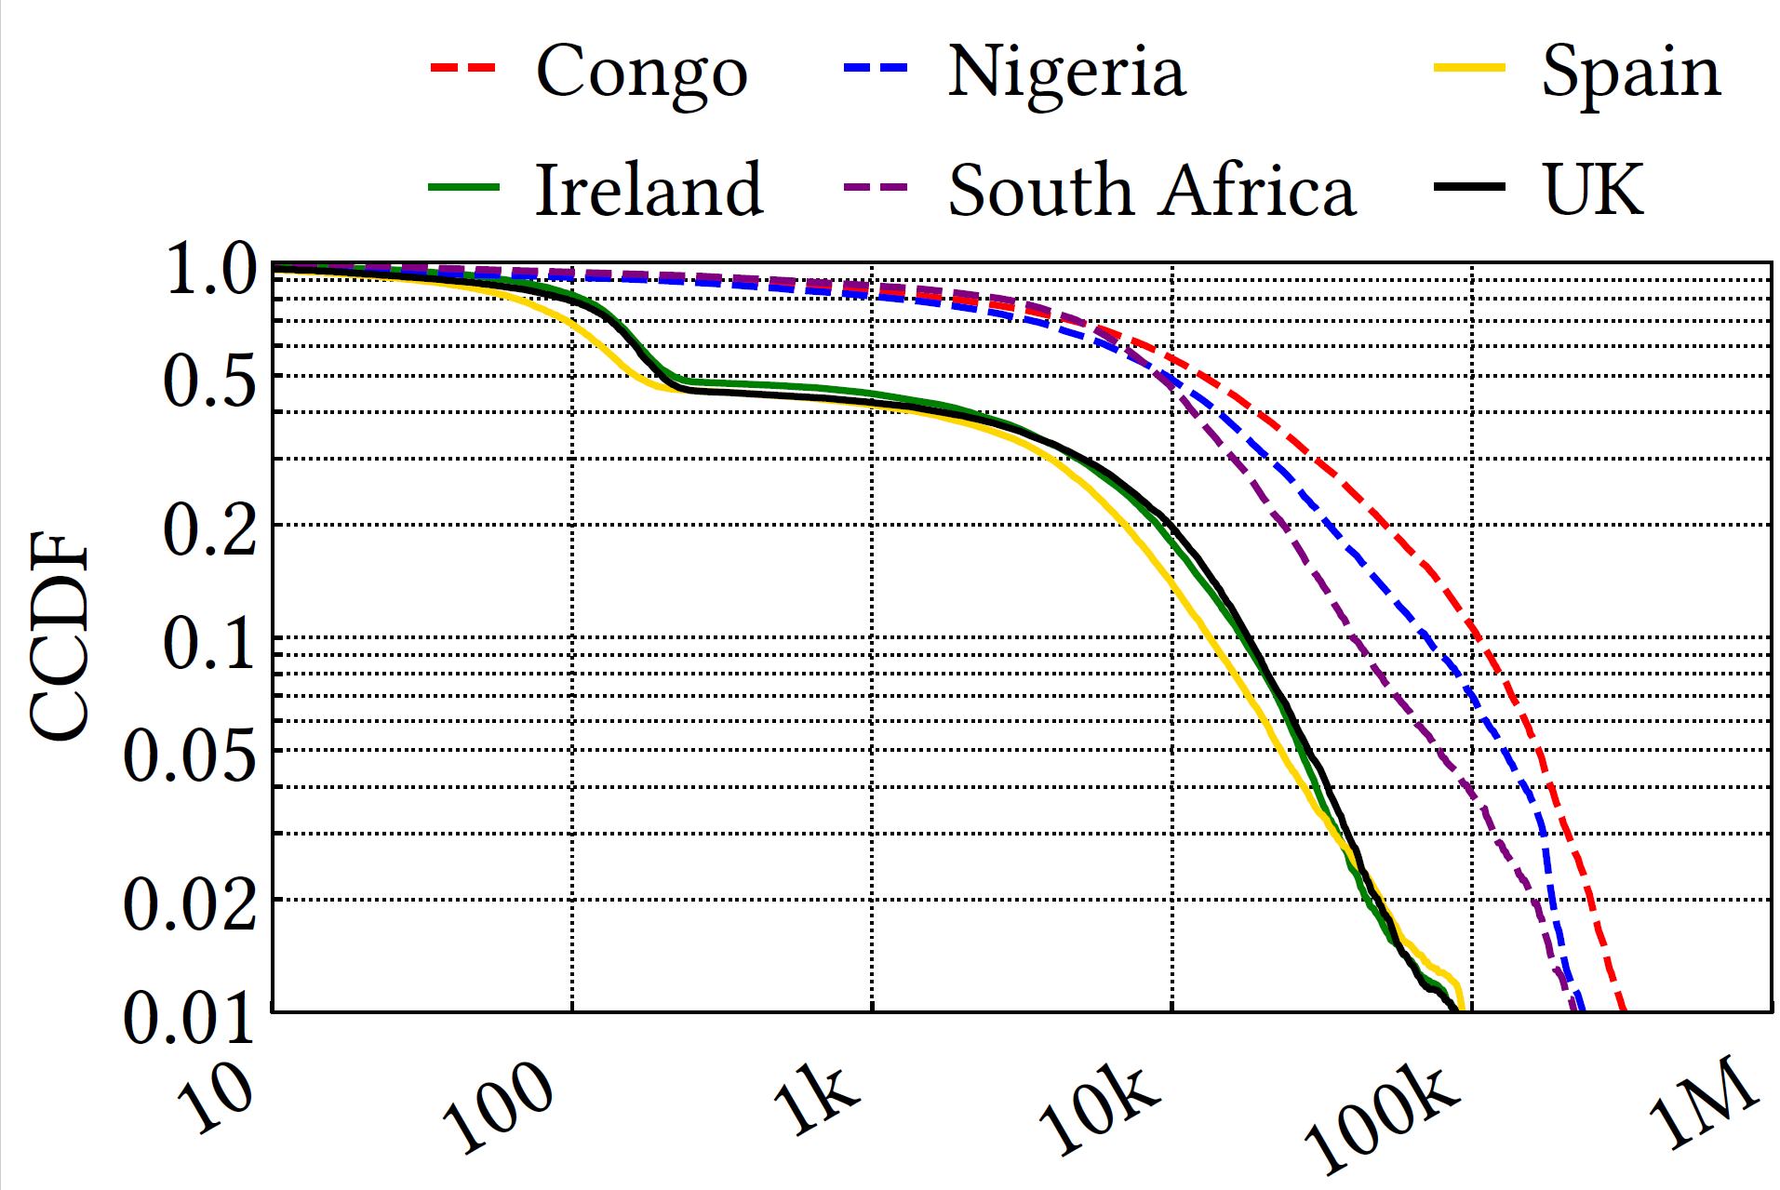
How much customers consume?
Complementary Cumulative Distribution Function (CCDF) of the daily number of flows per customer
Europe
High percentage of inactive customers
Africa
Most customers are active
Produce more flows than European customers
Internet access may be shared by several devices in the same household/business/internet café
250
Focus on active clients only
Clients with > 250 flows/day

Slide 12
How much customers consume?
Complementary Cumulative Distribution Function (CCDF) of the daily download volume per active customer
African customers download more data than European customers
Smaller increase in terms of volume difference
Heavy hitters (download > 10GB/day)
In Congo 8% while in Spain 4%
This behavior impacts the
Congestion on the SatCom link
The per-customer cost of the SatCom operator in terms of volume

Slide 13
What customers consume?

Slide 14
What users consume
Identify domain names
QUIC and TLS SNI
DNS queries
HTTP hostname
Service identification
List of services and associated set of domains (regexes)*
assets.nflxext.com
.netflix. .nflxext. .nflximg. .nflxvideo. .nflxso.
Netflix
*Full list at https://dl.acm.org/doi/10.1145/3517745.3561432

Slide 15
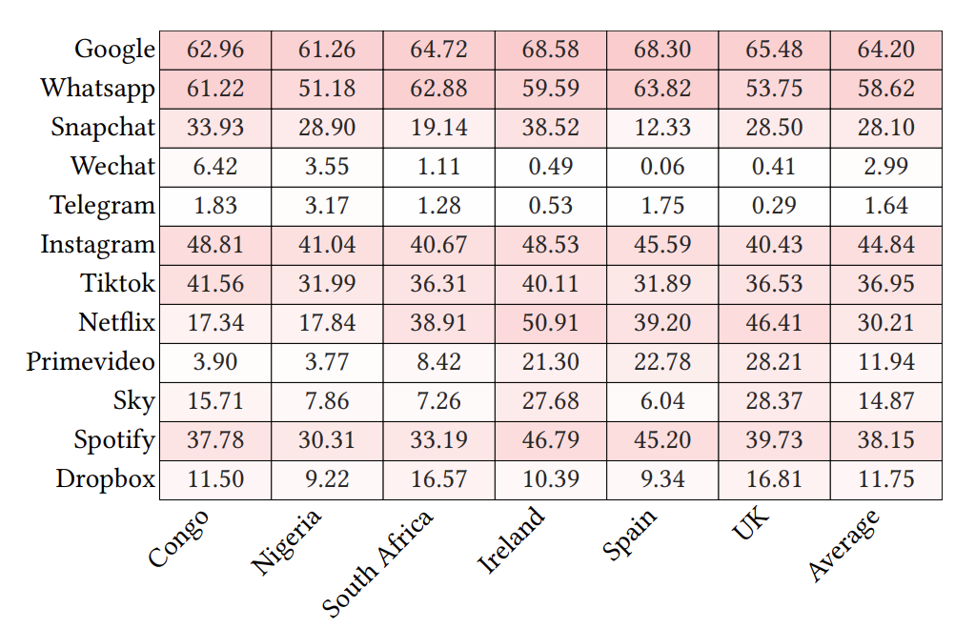
What service customers consume?
Service popularity per country for active customers
% of customers accessing each service
Focus on the service the customer wants to contact
Remove services that can be contacted during other visits, e.g., YouTube
Chat
Whatsapp has the highest popularity
Snapchat is 2nd. Highly popular in Congo and Ireland
Social
Instagram and TikTok have similar popularity
TikTok only 4 to 7 < Instagram
Audio/Video streaming
Are more popular in Europe than in Africa except for South Africa

Slide 16
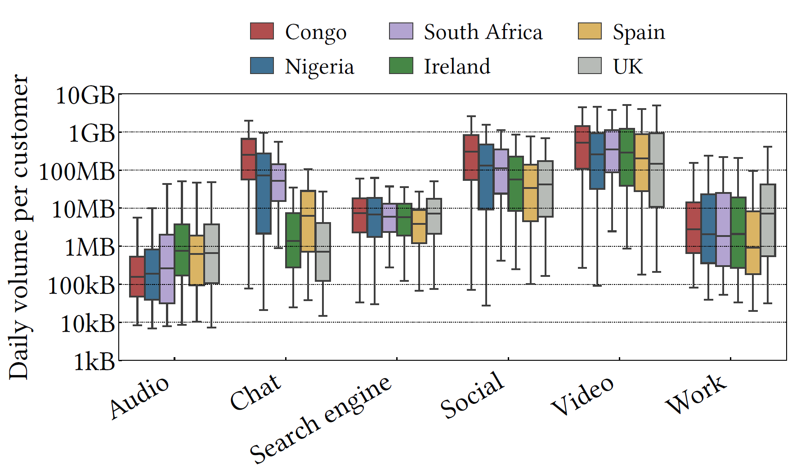
What category of service customers consume?
Volume per service category per country for active customers
All services: social buttons, tracking cookies, etc., consume little volume compared to the actual service
Chat
Median European consumes < 10 MB/day
Median African consumes > 250 MB/day
Top-5 % of the heaviest customers consume > 2 GB/day!
Social
Median European consumes < 30 MB/day
Median African consumes > 300 MB/day in Congo
Audio/Video streaming
Similar volume in all countries
But different services!
Free YouTube in Africa, paid streaming services in Europe
Higher Chat and Social volume may be
related to the sharing of SatCom connection

Slide 17
Which performance customers get?

Slide 18
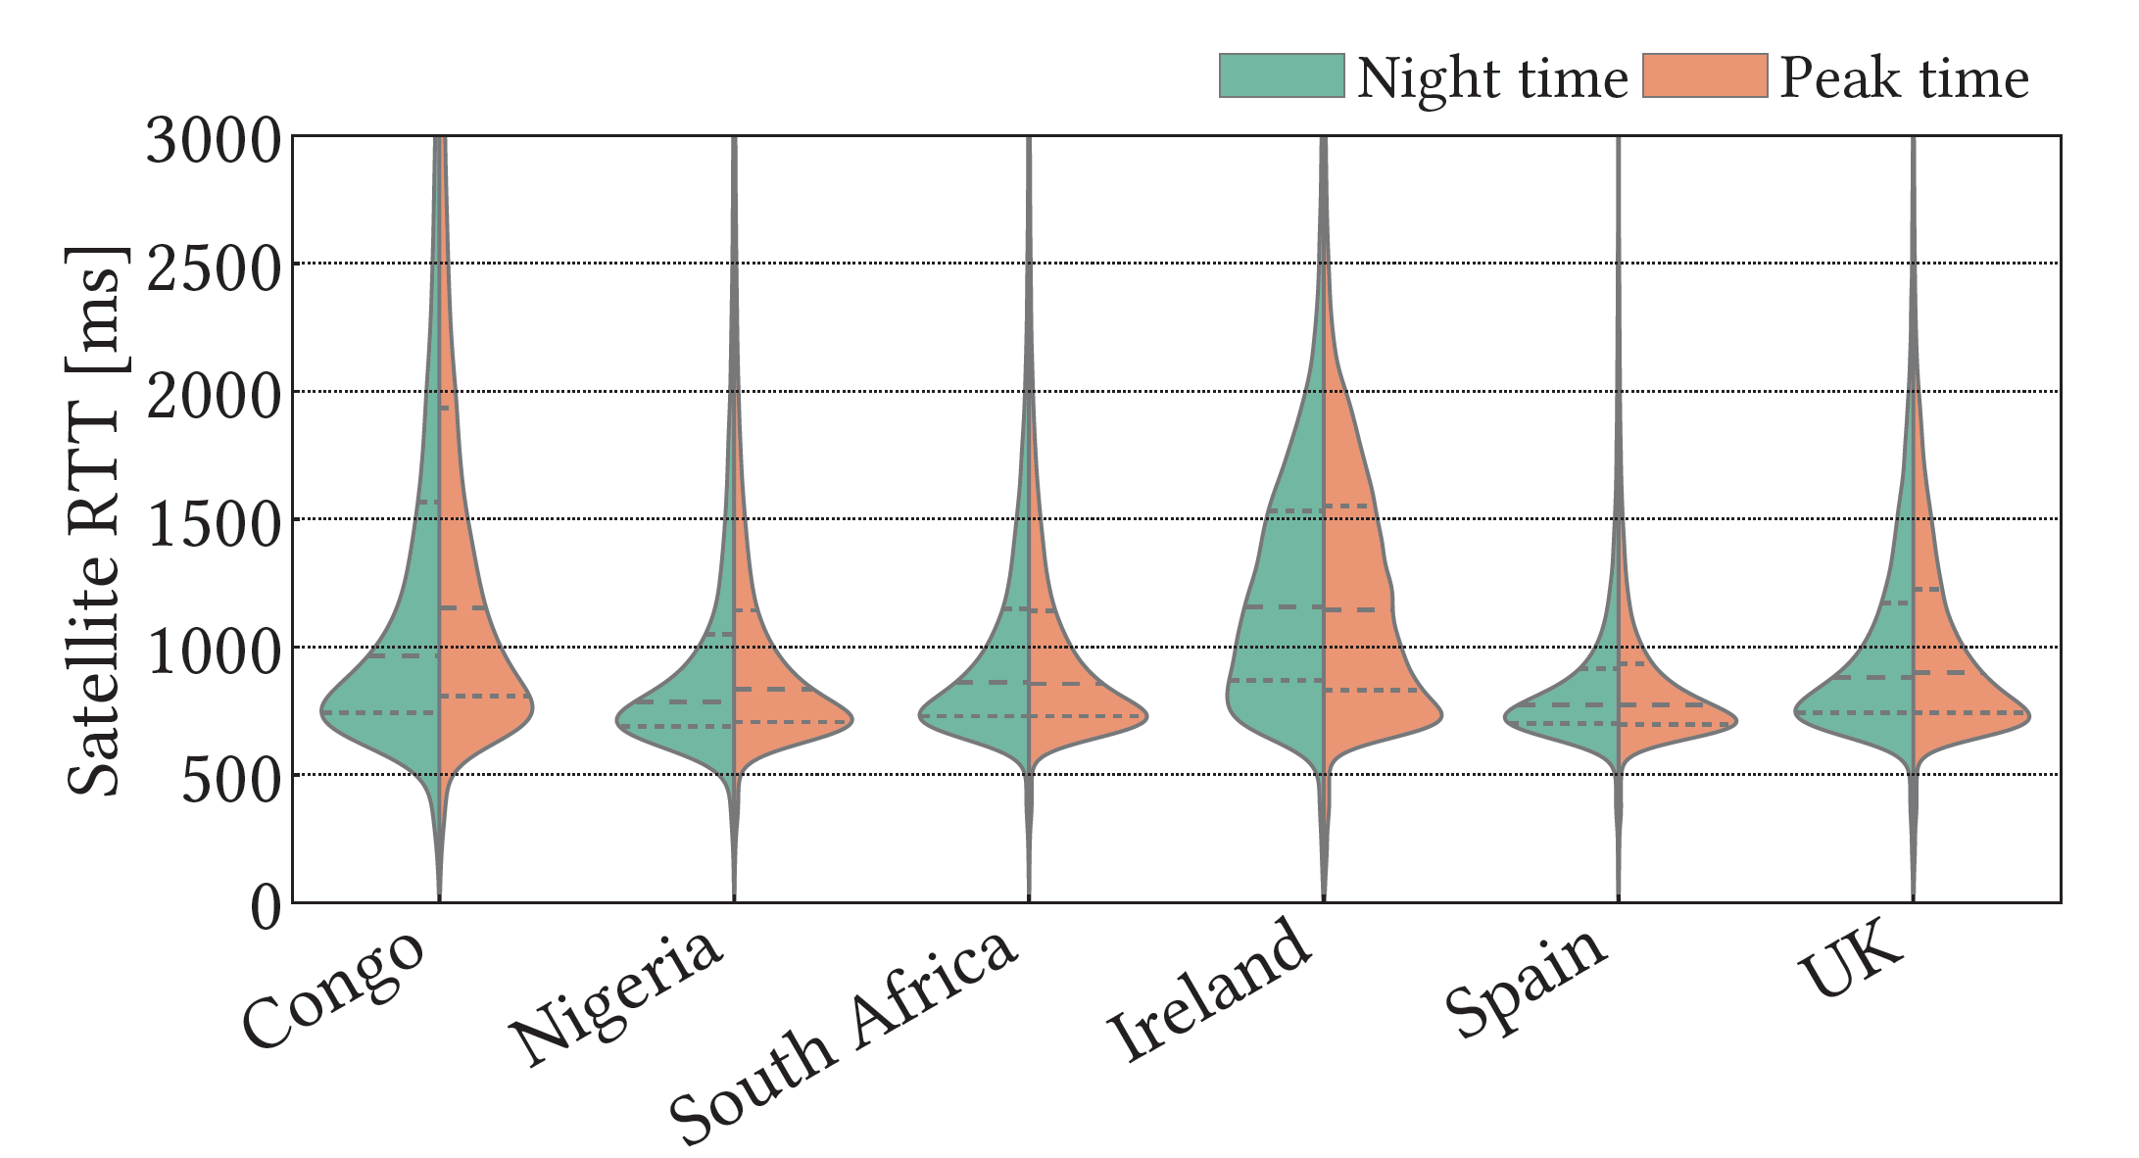
Which Performance customers get? (Satellite RTT)
Distribution of Satellite RTT during
Peak time (13:00 – 20:00)
Night (off-peak 2:00 – 5:00)
Satellite RTT: time from the customer terminal to the ground station
RTT min at 550 ms and > 2 s
Spain and Nigeria best RTT
Favorable location
Congo highly differ between peak and night
Possible congestion problem
Ireland no difference between peak and night hours, but poor performance
Possible location problem

Slide 19
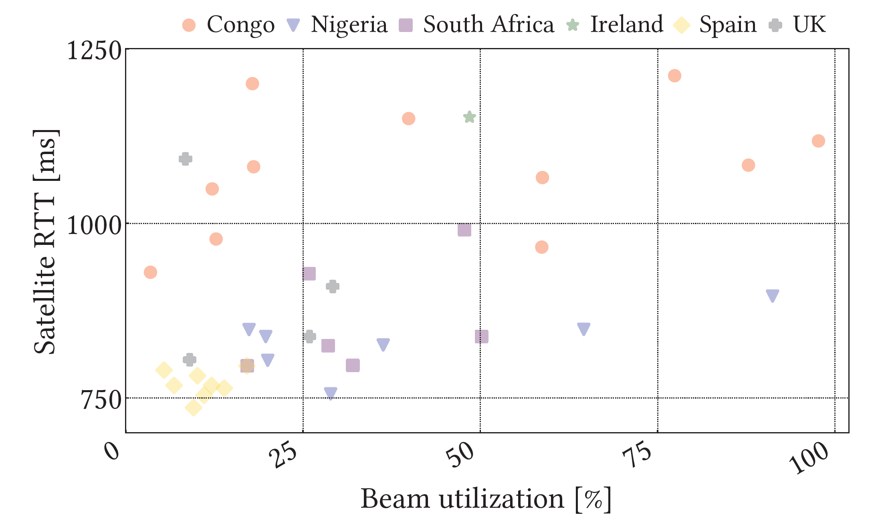
Which Performance customers get? (Satellite RTT and Beam utilization)
Distribution of Satellite RTT versus beam utilization during the peak time
Beam utilization is normalized based on the maximum utilization of all beams to avoid disclosing the actual per-beam utilization
Congo and Ireland suffer high delay
Independent of the beam utilization
Congestion is due to the PEP not the beam
Due to beam resource allocation
➔ The complexity of SatCom is higher than expected!

Slide 20
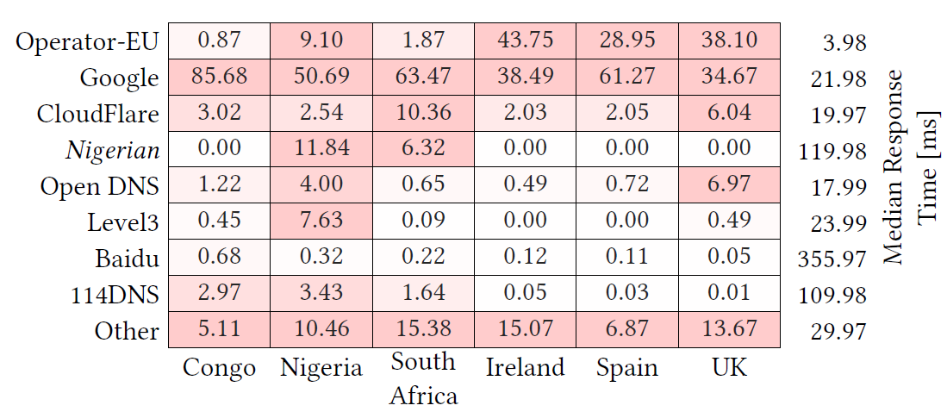
Which Performance customers get? (DNS & RTT based)
DNS popularity and response time per DNS resolver
% of active customers
Most customers set their own DNS
Regardless of the lowest Response Time
Especially in Africa
In Africa, customers often use Nigerian and Chinese DNS
High impact of the ground segment

Slide 21
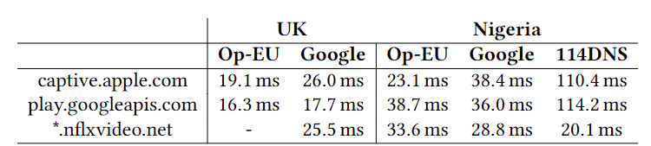
Which Performance customers get? (DNS & RTT based)
Impact of DNS resolver on the ground RTT
Ground RTT: time from the ground station to the actual server
Same service, different CDN based on DNS resolver
➔ Potentially leading to very high ground RTT

Slide 22
Conclusion

Slide 23
Conclusion & Future Work
Conclusion
Different customer patterns among countries
African countries could share Internet access
European countries may use it only if forced to do so
European countries are more likely to use satellite at night or during leisure time
African countries use the satellite to a significant extent throughout the day
The satellite RTT changes not only based on beam congestion
DNS resolution plays a key role in selecting the closest server in the CDN
Future work
Using IPv6 to study the phenomenon of connection sharing in Africa
Investigate how QUIC and other UDP-based protocols evolve over time

Slide 24


