Slide 1

Ivica Ivanović
General Director of Directorate for Information Society Promotion

Slide 2

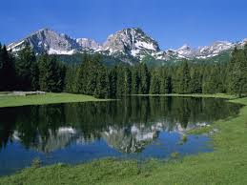
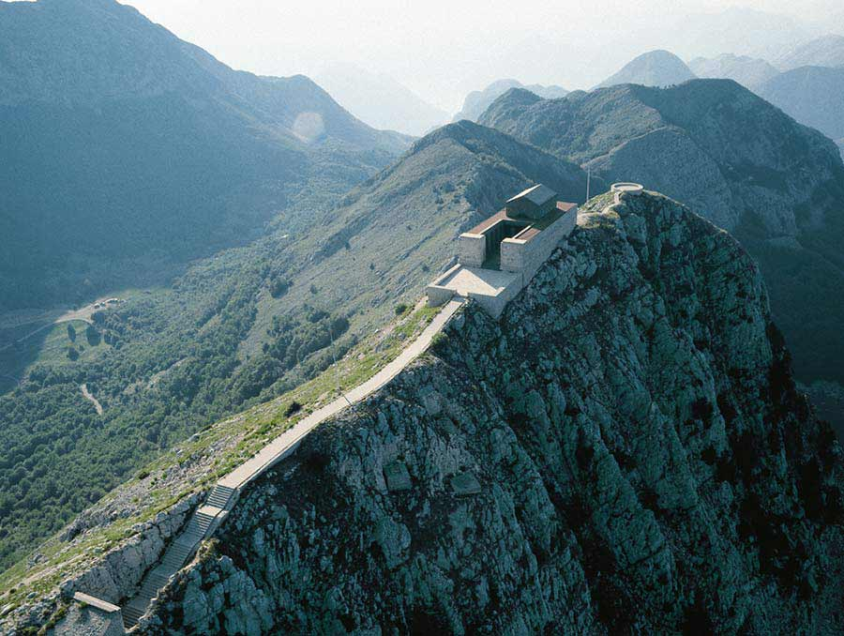
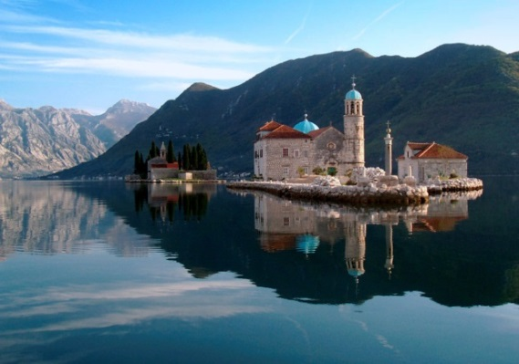
Montenegro
Montenegro is a country located in Southeastern part of Europe – on Balkan peninsula. Following a referendum held in May 2006, Montenegro declared independence on 3 June 2006.
With magnificent Adriatic Coast, amazing Lakes, 5 National Parks and gorgeous Mountains, this small, but beautiful country is bordered by Albania, Kosovo, Serbia, Bosnia and Croatia. Podgorica is Montenegro Capital City, while Cetinje is proclaimed like a Royal Capital City. Just couple of hours by plane from all main European centres, Montenegro is located in the perfect spot.
Tourism is main industry in Montenegro, and in last couple of years, Montenegro is always selected in Top World Tourist Destination. With population of 670K, very proud of the rich history and tradition, Montenegro primarily offers exceptional cordiality and hospitality.

Slide 3

Why Montenegro?
We wish to host this event in order to put Montenegro even more highly on a map of Internet experts and professionals worldwide, to present our capacities and opportunities as a thriving society in the field of both ICT and tourism, and offer our cooperation in organizing important events that reflect the interconnectedness and global reach of a modern world technologies and networks.

Slide 4
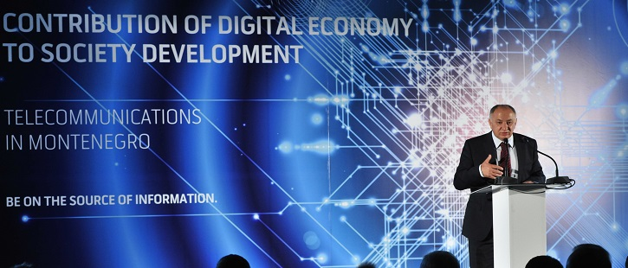

The Ministry for Information Society and Telecommunications of the Government of Montenegro is a state institution responsible for the development of all aspects of Information Society and Telecommunications in Montenegro and involved in all regional initiatives as well.
As such, it represents the natural partner for organization of the South-East Europe (SEE) RIPE NCC Regional Meeting.

Slide 5
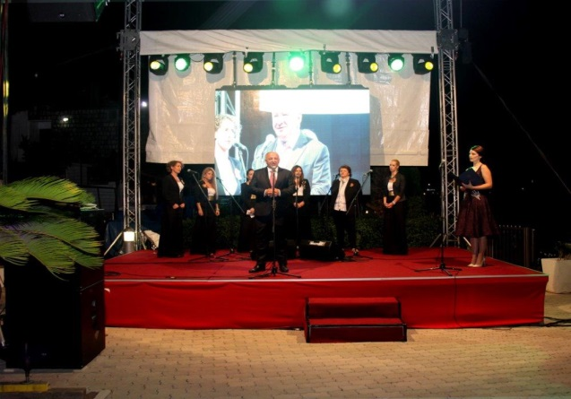

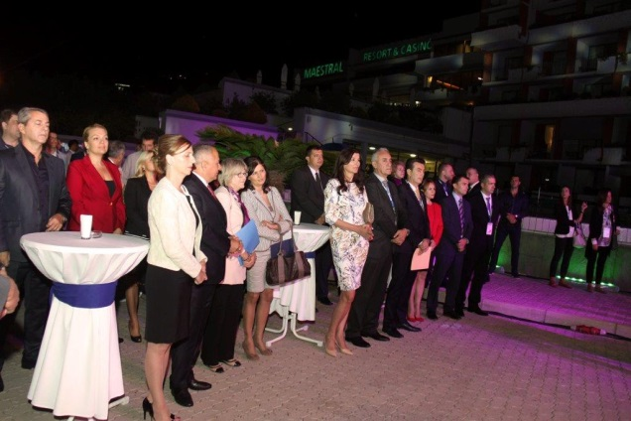
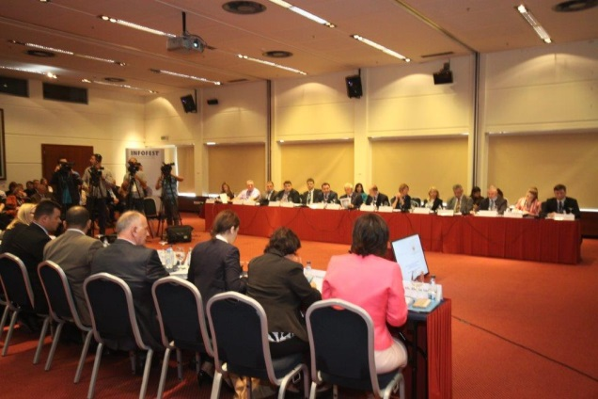
XXIII FESTIVAL OF INFORMATION TEHNOLOGY ACHIEVEMENTS
September 25th – October 1st, Milocer - Budva
INFOFEST represents the most significant event of this kind in the region, and as such was proclaimed an event of national importance by the Government of Montenegro.
The most important companies in the field, coming from the Balkan region and worlwide, will present their work at this year's INFOFEST.

Slide 6

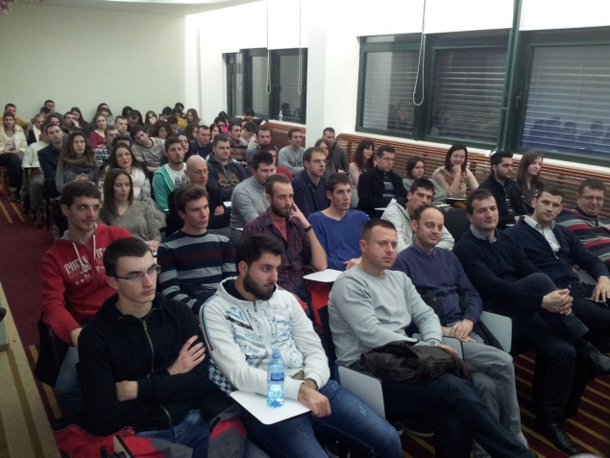


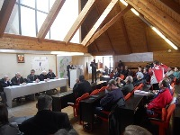
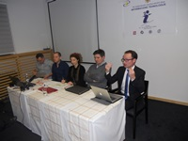
XXII International Scientific Conference Information Technology 2016
February, Žabljak
IT hosts lectures and round table discussions about development trends in the field of information and communication technologies, as well as actual problems in this field in Montenegro.
Relevant ICT institutions can organize presentations of their scientific research, professional, developmental and production projects and achievements.

Slide 7
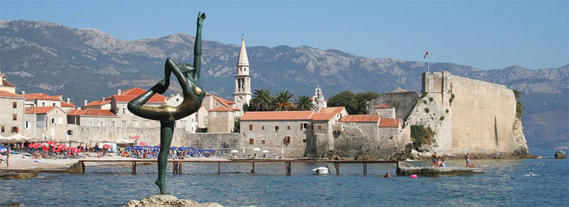
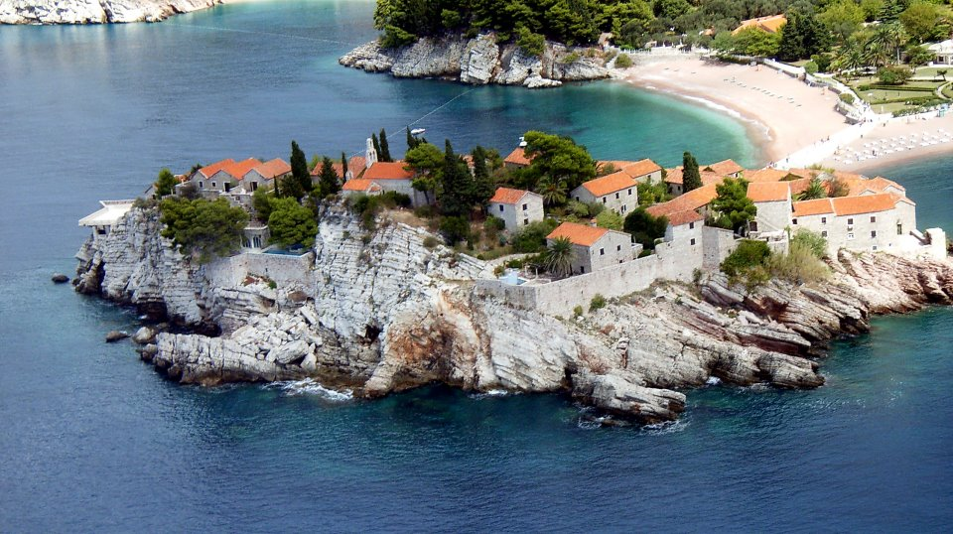
BUDVA
We would like to suggest Budva, home of INFOFEST and the city on Montenegrin Adriatic coast, to host SEE 6 in June 2017.
Budva is located:
24 km from Tivat international airport
55 km from Podgorica international airport
90 km from Dubrovnik international airport
Budva is 2,500 years old, which makes it one of the oldest settlements on the Adriatic sea coast.
Throughout centuries, Budva has been the synonym for culture, free thinking and creativity, and cultural happenings in summer season have made this town one of main cultural centers in the country.

Slide 8

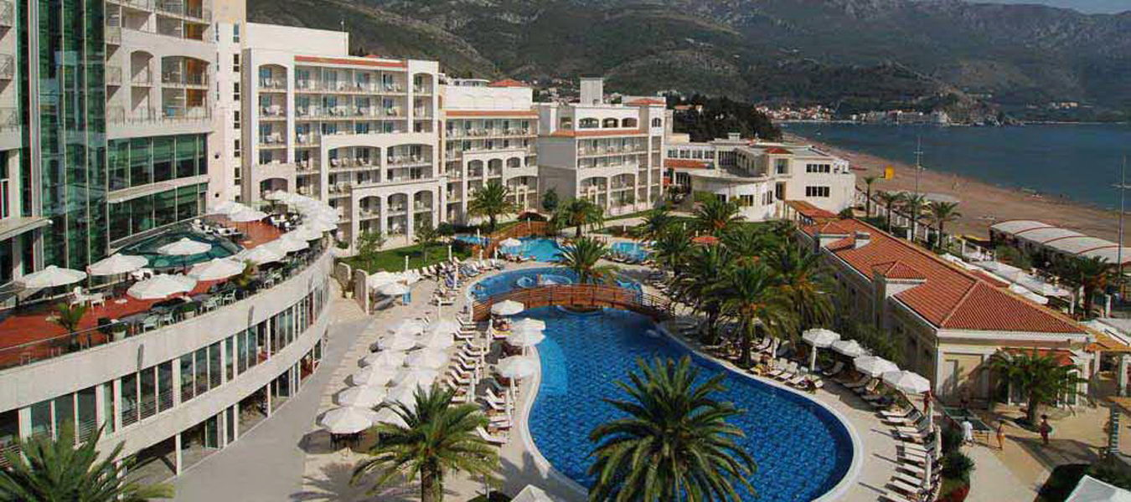
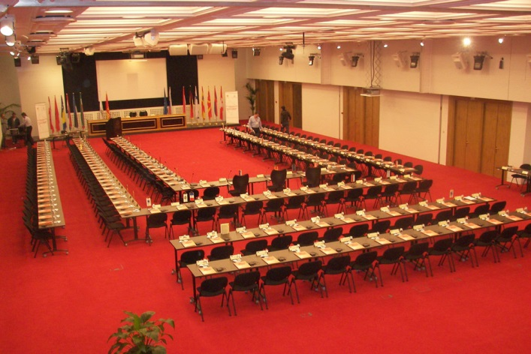
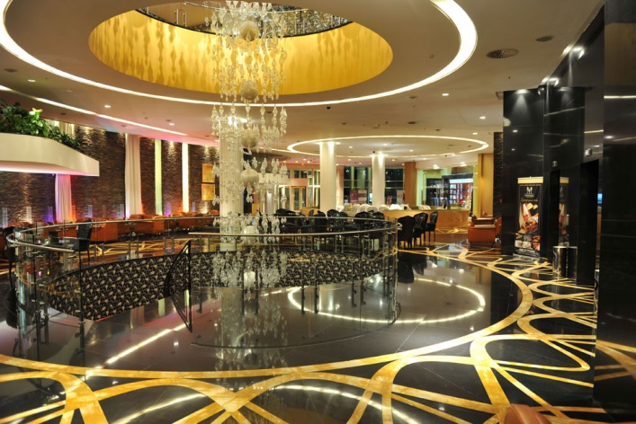
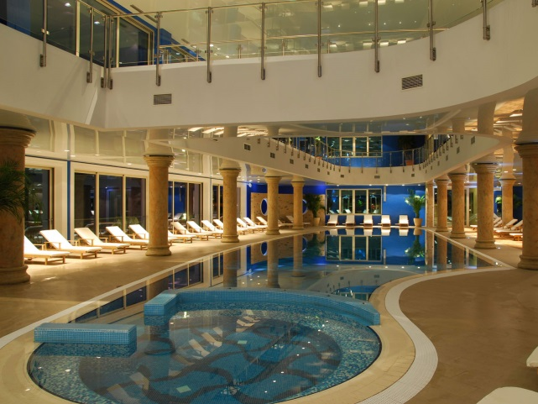
www.montenegrostars.com

Slide 9
Our responsibilities will include:
- assistance in finding a venue for the meeting, preferably in a hotel, for 250-300 participants
- assistance in finding a suitable venue for an evening social event with dinner
- provision of Internet connectivity (minimum 250 Mbps) to the meeting venue with a
- sufficient number of wireless access points
- assistance in finding suitable local sponsors for the event
- invitation to local government officials
- local support before and during the event
- local PR for the event (via local press and appropriate mailing lists, in close cooperation with the SEE organizational team)
- assistance in finding local representatives to present at and participate in the meeting
- support in providing invitation letters for visas for participants when needed
- assistance in finding a suitable webcast service for the event
- assistance in finding a photographer for the event
- assistance with printed material for the event
- provision of three (3) staff members to assist with registration and other duties during the meeting.

Slide 10
Thank you for your attention and hopefully that we see you in Montenegro in 2017!
Ivica Ivanovic
Email: ivica.ivanovic@mid.gov.me, Tel: + 382 69 010 707

