Slide 1

Deploy360 Programme
Technical Info, BCOP, DNSSEC Coordination, ION Conferences

Slide 2
About Deploy360
The Challenge:
    The IETF creates protocols based on open standards, but some are not widely known or deployed
    People seeking to implement these protocols are confused by a lack of clear, concise deployment information
The Deploy360 solution:
    Provide hands-on information on IPv6, DNSSEC, TLS for Applications, Securing BGP, and Anti-spoofing to advance real-world deployment
    Work with first adopters to collect and create technical resources and distribute these resources to fast following networks

Slide 3
Deploy360 Components
Web Portal
(Online knowledge repository)
Social Media
(Constant audience engagement)
Operators Meetings
(Come meet us or invite us to Speak)
ION Conferences
(Hands-on educational events)
Technical documents
Blogs
Twitter
Facebook
YouTube
Costa Rica (3 Jul)
South Africa (Sep tbc)
Case Studies
Tutorials and Guides
Serbia (3rd week Nov)
Malta (18 Sep)
Technical presentations
Sponsorship
Facilitating start-up
Programme Committees

Slide 4
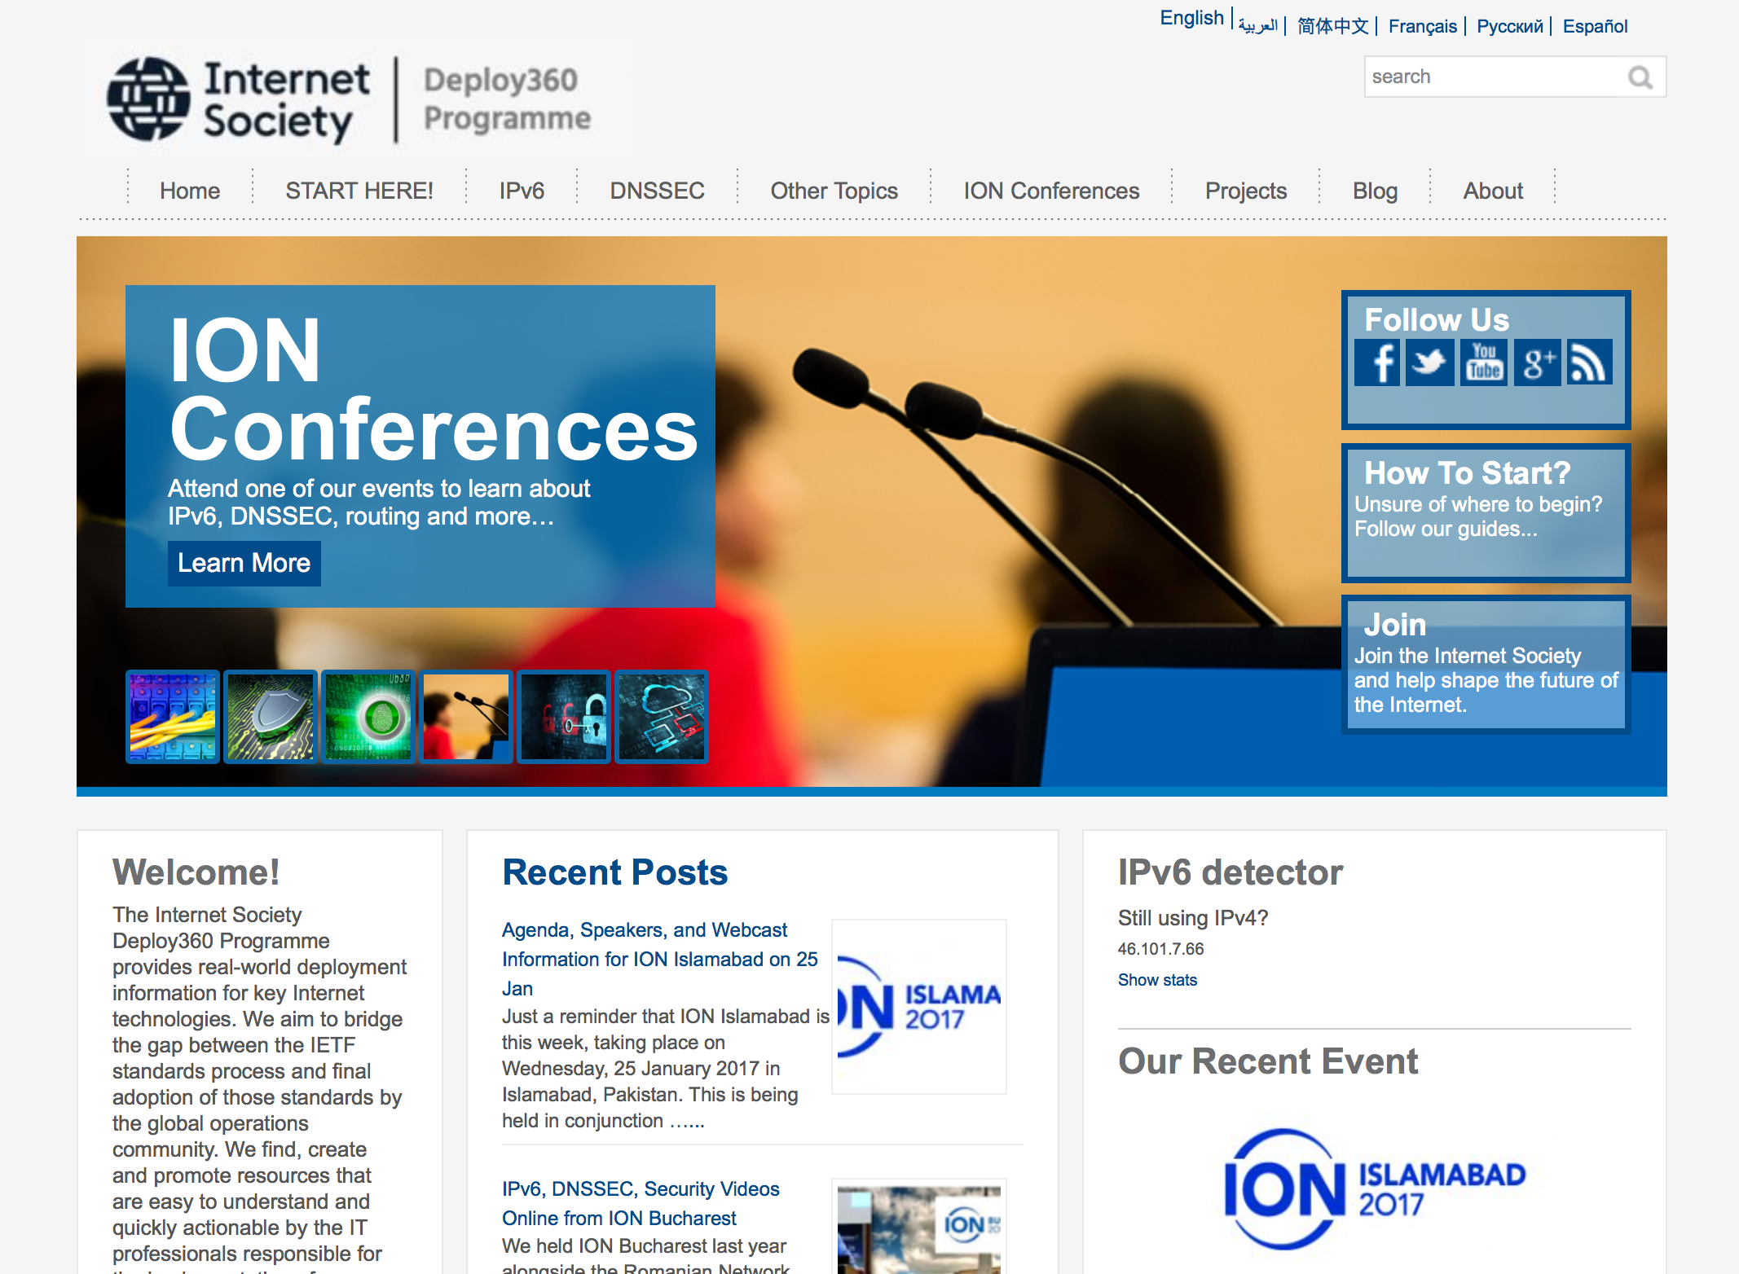
Web Portal – http://www.isoc.org/deploy360
  IPv6, DNSSEC, Securing BGP, TLS for Applications, Anti-Spoofing knowledge base including tutorials, case studies, training resources, etc..
  Content specific to:
    Network Operators
    Developers
    Content Providers
    Consumer Electronics
    Manufacturers
    Enterprise Customers
  Blog posts
  Social media integration

Slide 5
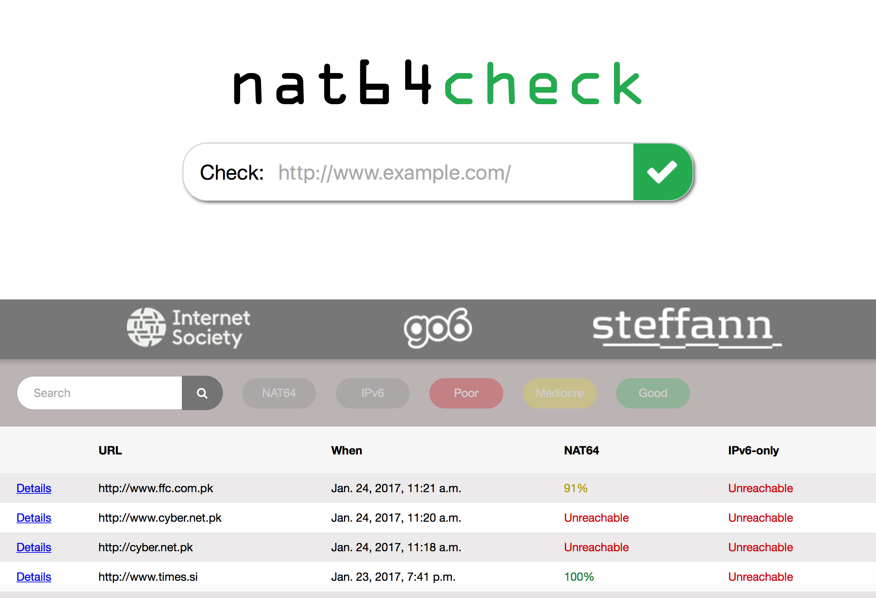
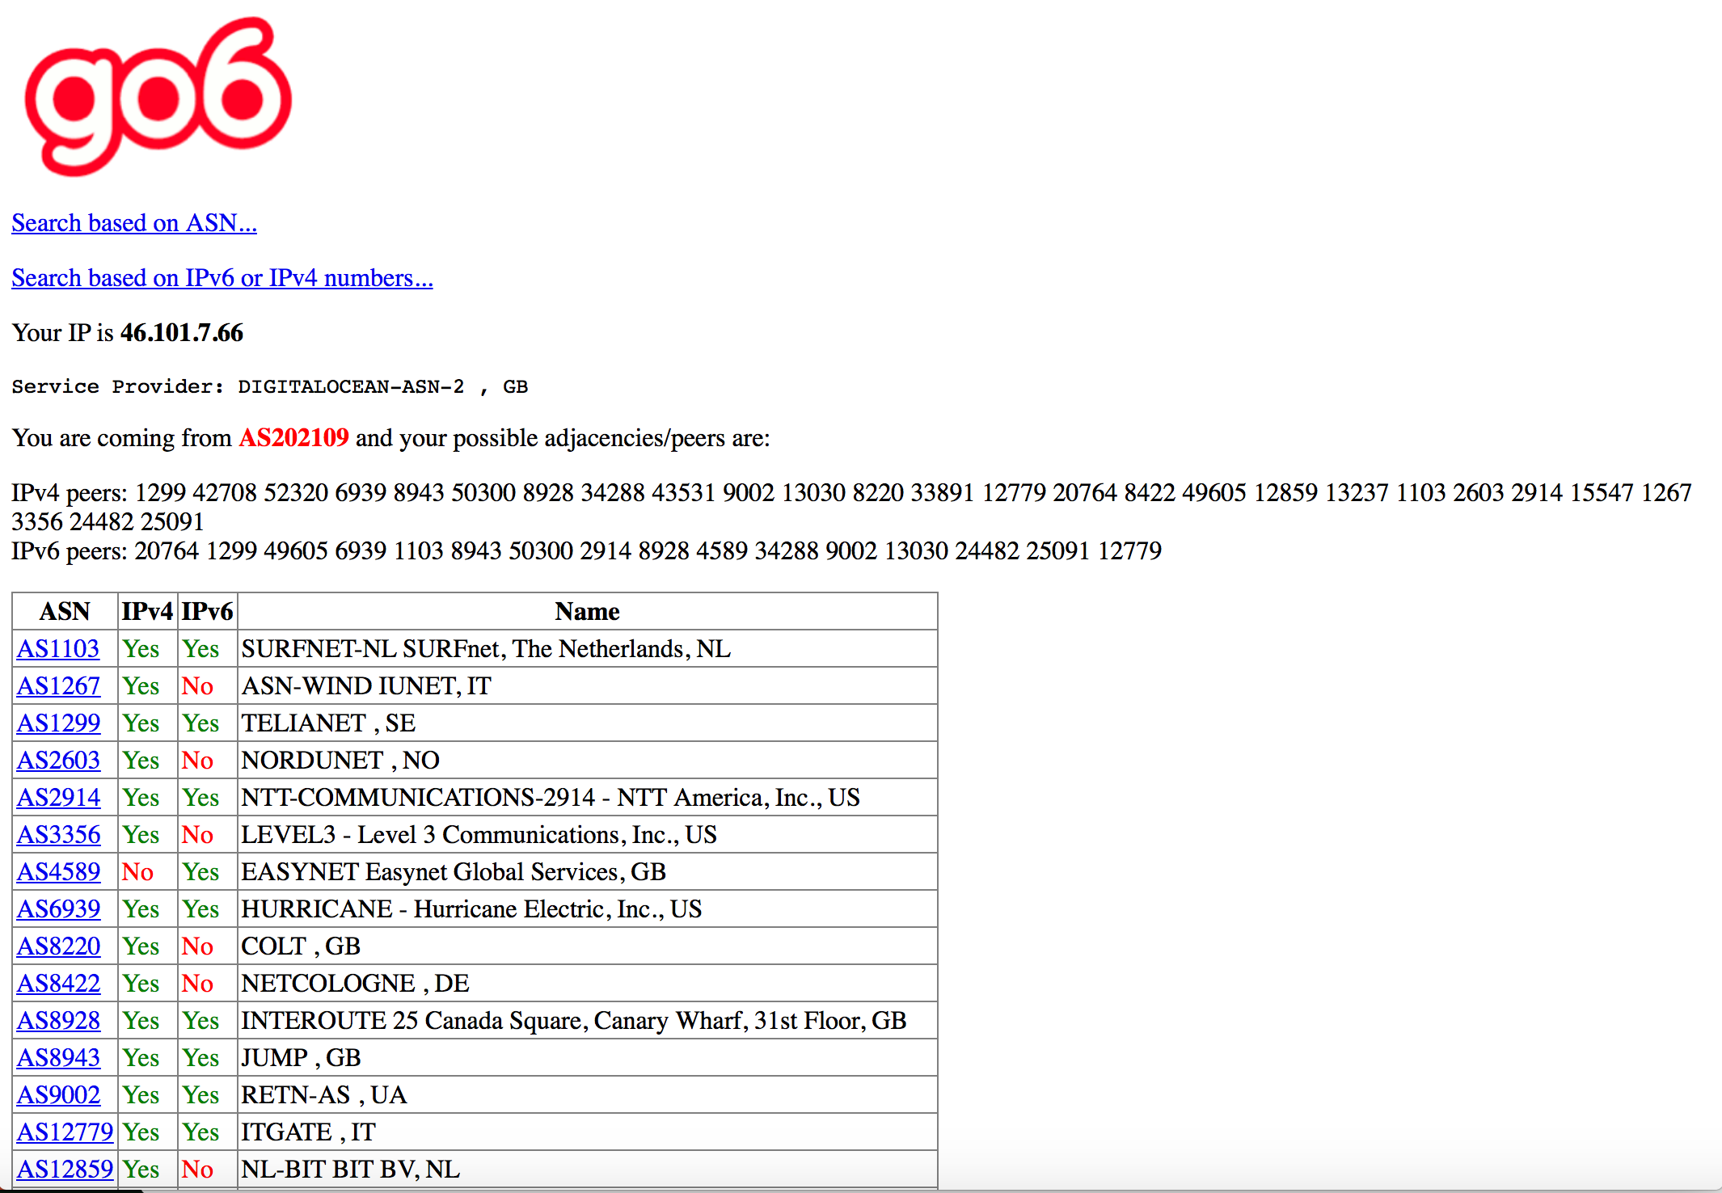
Some resources
  NAT64check
  Checks websites display properly over IPv4, IPv6-only and NAT64
  https://nat64check.go6lab.si/
  BGP@Go6
  Compare BGP peering polices between IPv4 and IPv6 for different ASNs
  https://bgp.go6.si

Slide 6
DNSSEC Deployment Maps

Slide 7
Best Current Operational (BCOP) Practice Initiatives
RIPE BCOP TF – chaired by Jan Žorž & Benno Overreinder
    IPv6 prefix assignment for end-users: static or dynamic and what size to choose
    Mutually Agreed Norms for Routing Security (MANRS)
    Requirements for IPv6 in ICT Equipment (ripe-554)
    IPv6 troubleshooting for helpdesks (ripe-631)
    Controlled IPv6 deaggregation by large organisations
    IXPs
    BGP Best Practices
  See http://www.isoc.org/deploy360/projects/bcop/

Slide 8

We need your help!
Adding more content
    Actively engaging with industry professionals to curate or create deployment content
    Help us develop materials based on your experiences (we credit you)
    Point us to useful resources
    Tutorials, guides, HOWTOs, reports, white papers, tools, developer libraries and case studies
Suggest topics and features that should be included
Helping with translations

Slide 9

Take the Deploy360 Survey
What sort of organisations in our audience are deploying:
    IPv6
    DNSSEC
    DANE
    RPKI & other routing security measures
    TLS
What other technologies, if any, should we cover?
http://www.isoc.org/deploy360/survey/
Anyone taking the survey can opt into raffle for Raspberry Pi

Slide 10
Thanks!
Kevin Meynell
meynell@isoc.org
@Deploy360 (#IONConf)
http://www.isoc.org/deploy360

