Slide 1
Sustainability is good for the Internet (and business too!)
Michael J. Oghia
Independent consultant

Slide 2
We cannot legitimately
discuss Internet access
without addressing sustainability
@mikeoghia

Slide 3
What is sustainable access?
The ability for any
user to connect to
the Internet and then stay connected over time
@mikeoghia

Slide 4
Includes:
    Infrastructure & energy
    ICT & data transfer/storage power
    Sourcing, manufacturing, & recyclability
    of Internet-connected devices
    Human resources & skills
    Digital pollution & the availability of
    resources (e.g., IP & AS numbers; IPv6)
    Ecological impact
@mikeoghia

Slide 5
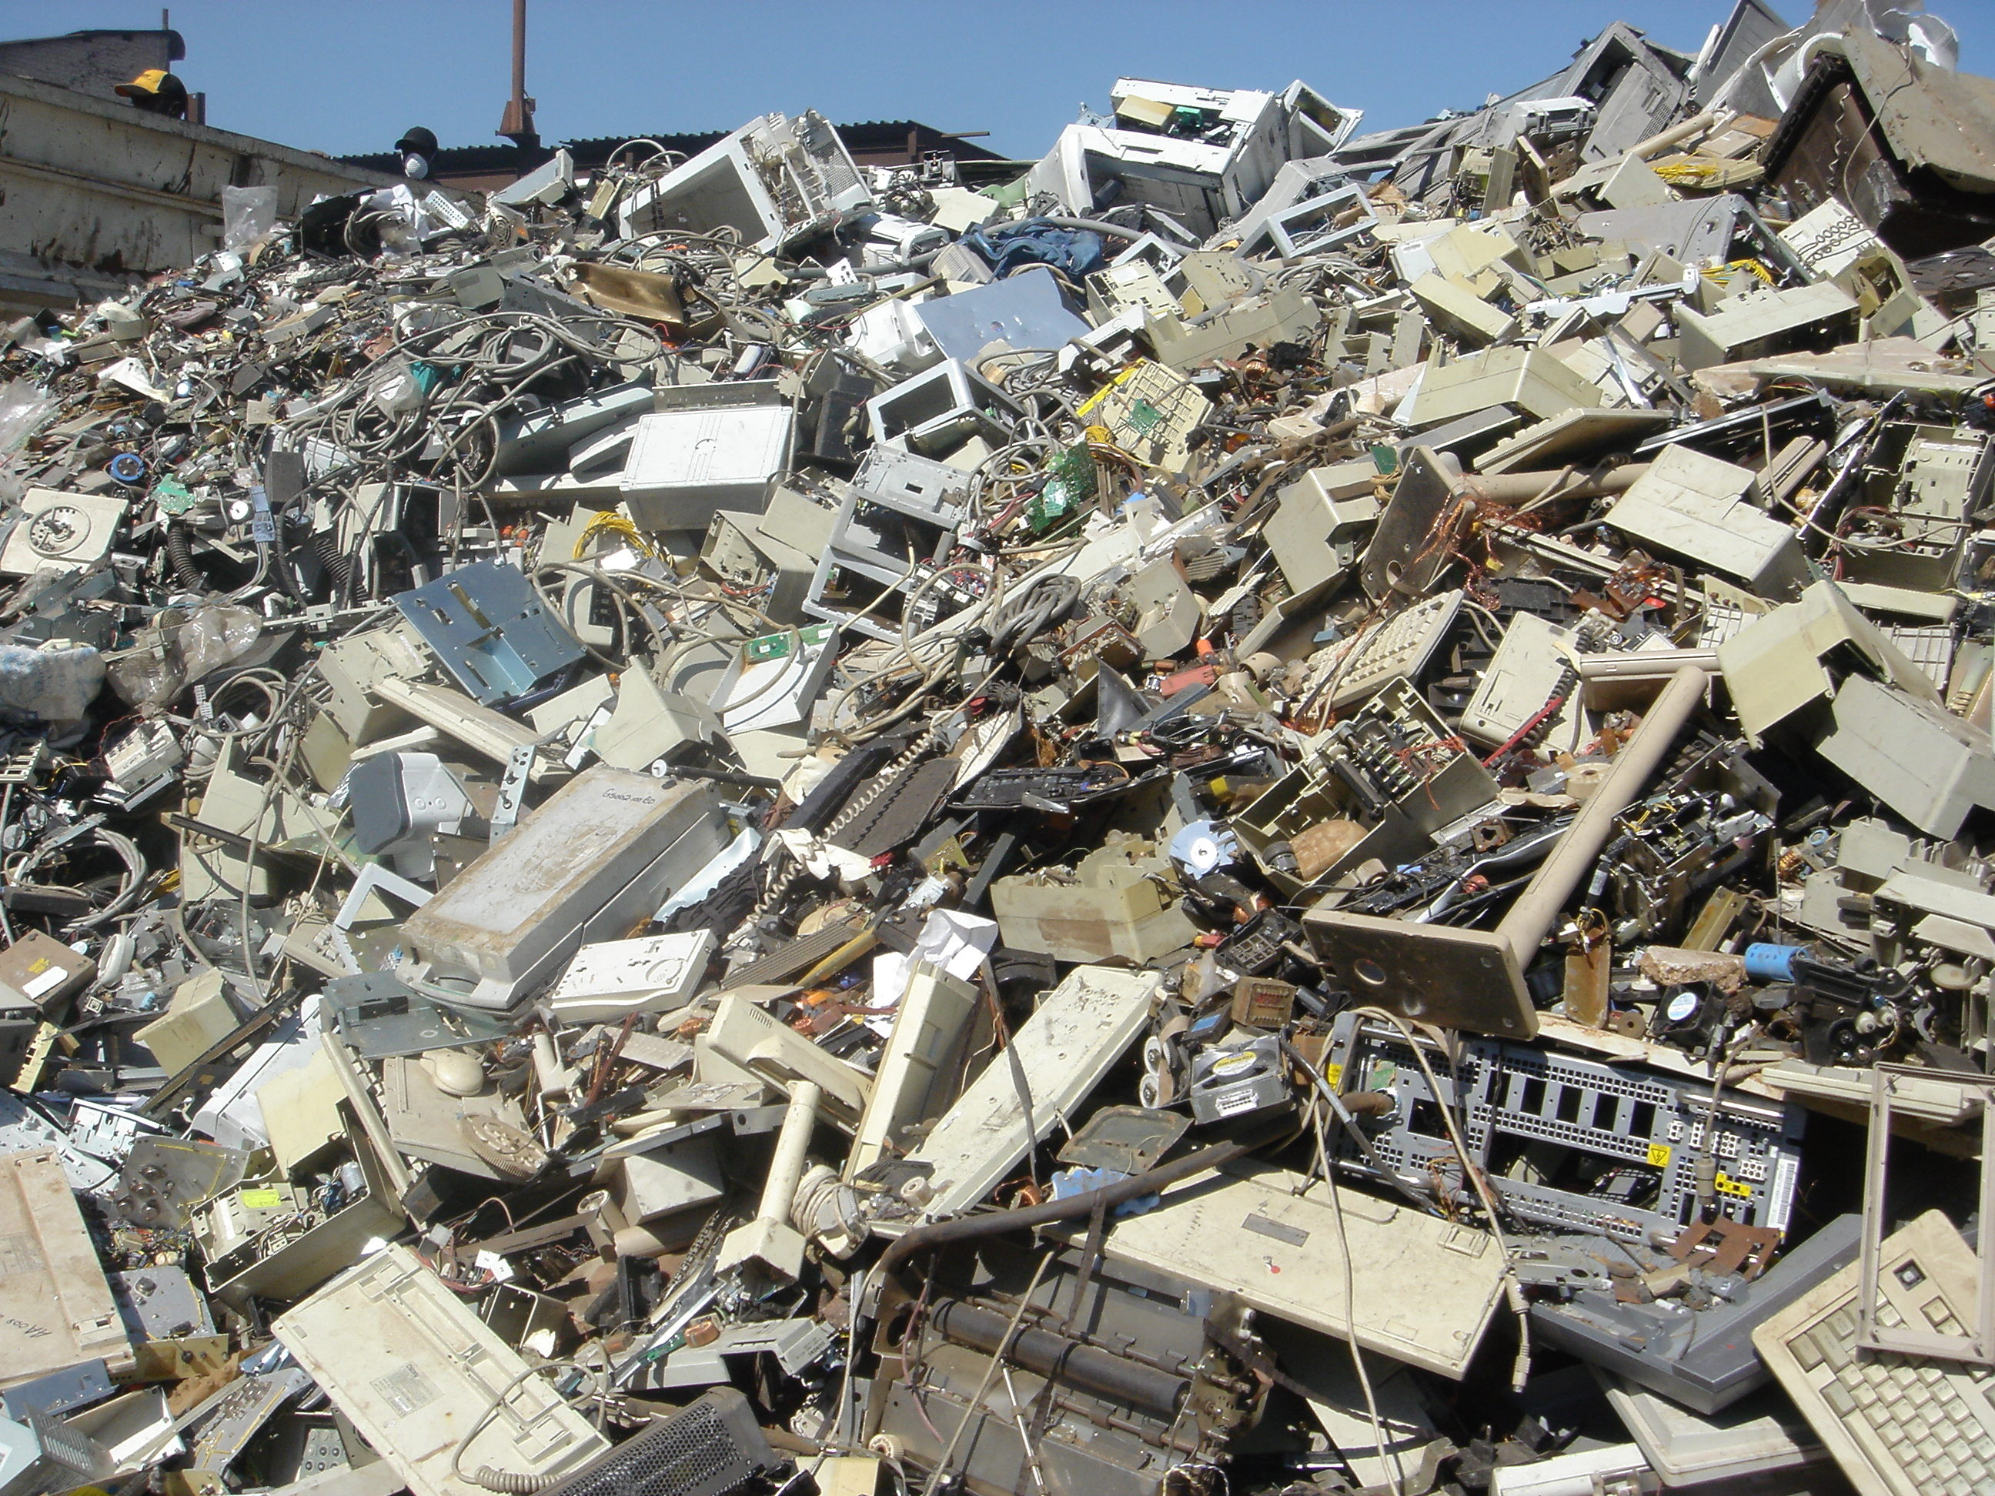

Slide 6
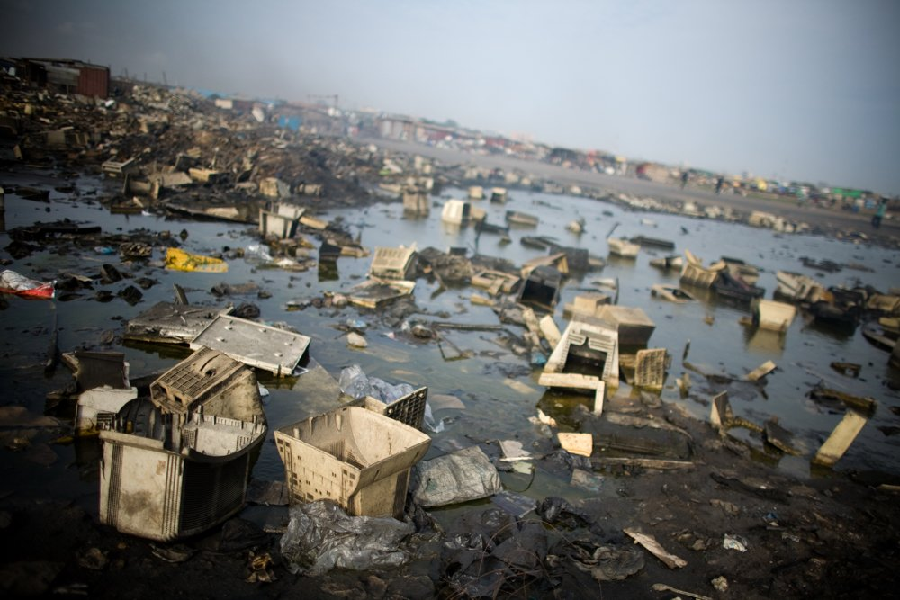

Slide 7
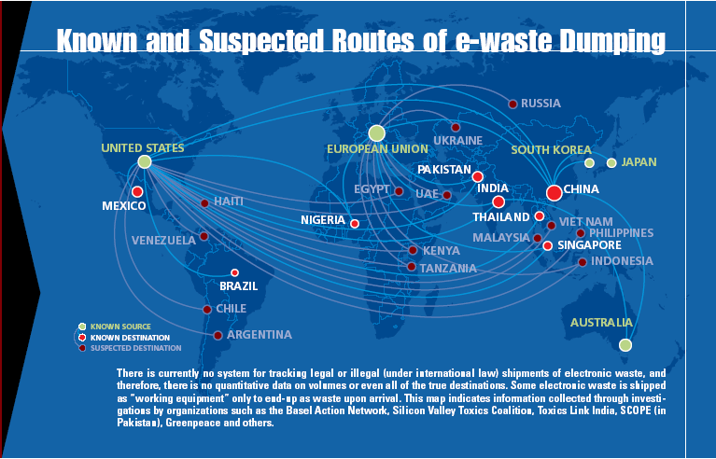
Source: www.oafrica.com/education/e-waste/

Slide 8
Why is it important?
Connect another billion people
ICT + M2M energy use is increasing
Digital technology has a significant
ecological footprint
Good for business
@mikeoghia

Slide 9
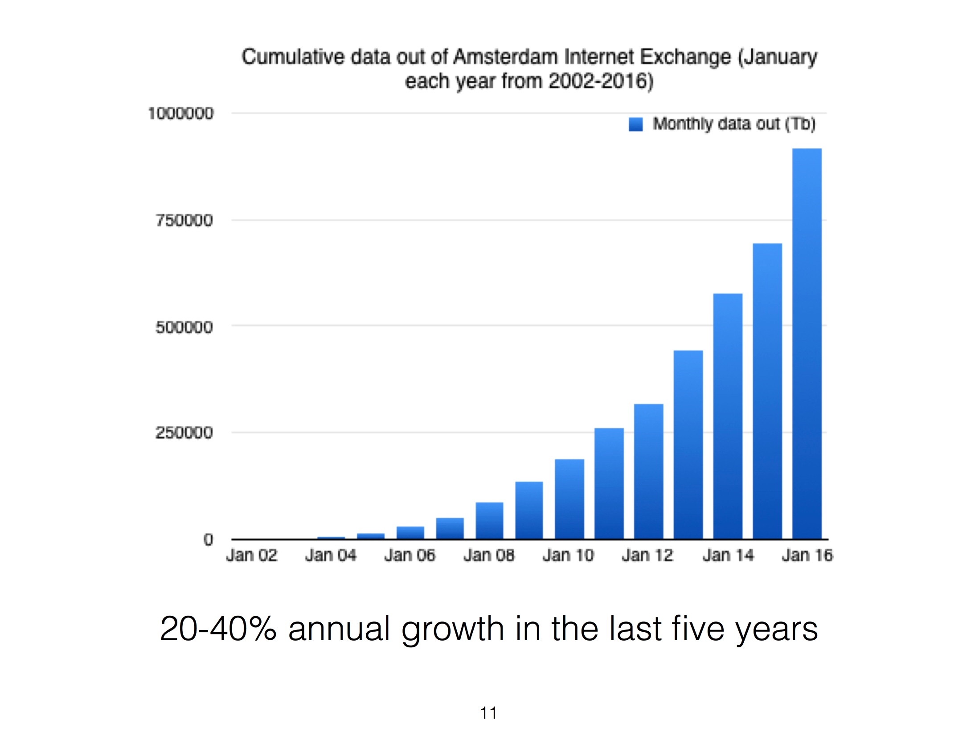
Source: Mike Hazas, PhD

Slide 10
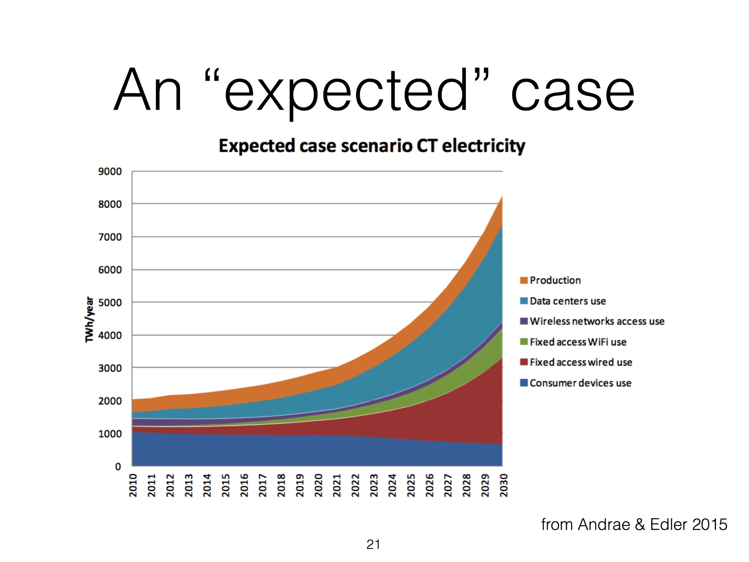
Source: Mike Hazas, PhD

Slide 11
ARMIX as an example
Armenian Internet exchange
Integrate renewable energy, promote green energy solutions, and reduce their electricity costs & consumption
ISOC donated 18 solar panels (≈ 4 kW)
https://internetsociety.org/blog/development/2017/06/armix
@mikeoghia

Slide 12
ARMIX as an example
Their electricity costs have dropped by more than 30%, & less reliance on nonrenewable energy sources
Example of enabling government policy-making, effective public-private partnerships, & sustainable planning
https://internetsociety.org/blog/development/2017/06/armix
@mikeoghia

Slide 13
Thank you! Questions?
Michael J. Oghia
mike.oghia@gmail.com
@mikeoghia
in/mikeoghia

