Slide 1
UNI.NET & DATACENTER
RASH infrastructure
Dr. Arjan Xhelaj
Mariglen Hysko
Andi Malaj
RIPE SEE7, 18-19 June 2018, Timisoara, Romania

Slide 2
About RASH
Albanian NREN
Founded in 2009, active from 2011
Mission:
  Connect Albanian public universities in e NREN; interconnect RASH to GEANT network and to the Internet
  Provide services to universities & Ministry:
    Software for University management
    Portals for Ministry of Educations, Sport and Youth
    Research and education interconnection
    Datacenter, Hosting infrastructure
RIPE SEE7, 18-19 June 2018, Timisoara, Romania

Slide 3
RASH Infrastructure
Own Datacenter from 2016
Datacenter network topology
Three separated dedicated spaces:
    Server room
    Network room
    Electrical room
N+1 UPS and on site generator
Cooling system
Antifire system, temperature &humitidy sensor
RIPE SEE7, 18-19 June 2018, Timisoara, Romania

Slide 4








Datacenter
Hosting services for universities and ministry of education
Offering different platform:
  ESSE3 – Manage Alumni Curricula in the University ^{(*)}
  UGOV ERP and Accounting Software – Manage University’s Finance ^{(*)}
  IRIS Research Portal – Manage scientific publications^{(*)}
  U-albania – university admissions portal^{(**)}
  M-albania– teachers portal ^{(**)}
  Research Census portal^{(**)}
  Training portal^{(**)}
  ^{(*) Cineca © ; (**) RASH ©}
RIPE SEE7, 18-19 June 2018, Timisoara, Romania

Slide 5
Unet-University Network
Unet network topology
Dark fiber network
4 Backbone area 10 Gbps
54 Point of presence, M-PoP + S-PoP with point-to-point 1Gbps
MAN of Tirana & Regionals campus network area
RIPE SEE7, 18-19 June 2018, Timisoara, Romania

Slide 6
eBGP and iBGP peering
RIPE SEE7, 18-19 June 2018, Timisoara, Romania

Slide 7
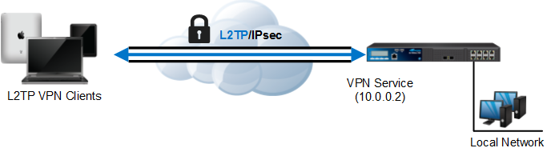
Our services
Internet and data
Public IP addresses
VPN services
DNS services
RADIUS Server
RIPE SEE7, 18-19 June 2018, Timisoara, Romania

Slide 8
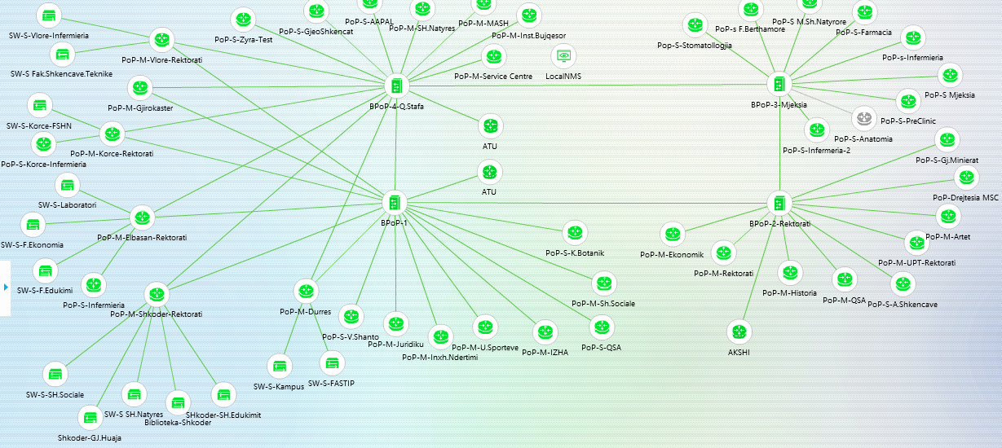
Esight Monitoring system
Esight server from Huawei offers different measurement:
  uptime, device configuration management&backup
  remote control (telnet, ssh, web)
  alarm notification via mail
RIPE SEE7, 18-19 June 2018, Timisoara, Romania

Slide 9
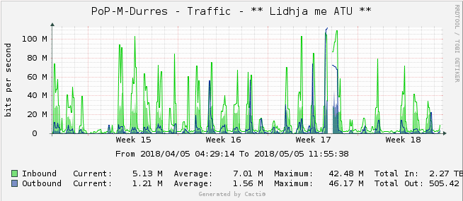
Other monitoring systems
Cacti server – uptime, bandwidth utilization
Nagios – uptime, ping, RTA, packet loss, latency, event logs
RIPE Atlas probes and an anchor
RIPE SEE7, 18-19 June 2018, Timisoara, Romania

Slide 10
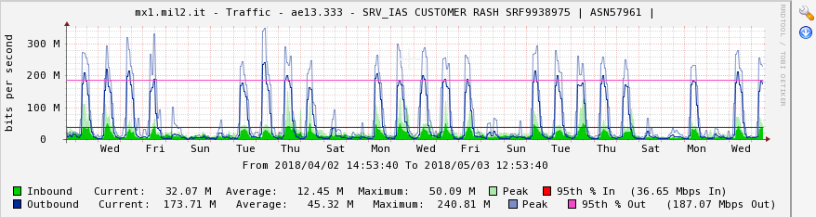
Network traffic
RIPE SEE7, 18-19 June 2018, Timisoara, Romania

Slide 11
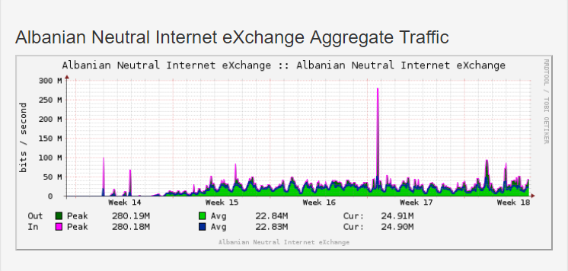
ANIX – Albanian Neutral Internet eXchange
IX hosted at RASH Datacenter
3 ISP connected
Managed by IXP Manager
RIPE SEE7, 18-19 June 2018, Timisoara, Romania

Slide 12
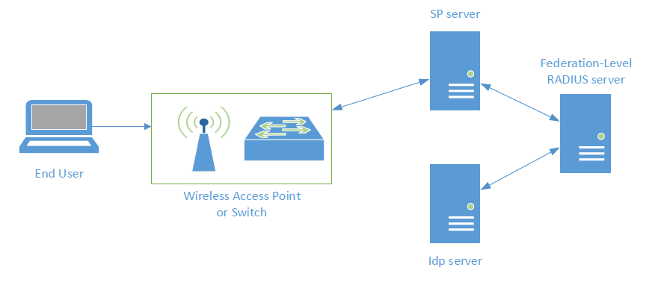
eduroam–education roaming
eduroam is the secure, world-wide roaming access service developed for the international R&E community
3 servers - SP, Idp, Flr
Freeradius 3.x
eduroam CAT tool
F-Ticks system for logging info
Implementation on RASH office
RIPE SEE7, 18-19 June 2018, Timisoara, Romania

Slide 13

Next step of eduroam
Implementing eduroam in universities
Installing and configuring APs
Configuring CAT tool for every institution
Configuring LDAP module for users management
Data integration of users (students&reserchers) with eduroam and Edugain
Implementing eduroam in the center of Tirana
RIPE SEE7, 18-19 June 2018, Timisoara, Romania

Slide 14
Future services
Software-Defined Networking (SDN)
PerfSONAR
Edugain
EduVPN
VoIP system
MPLS
IPv6
RIPE SEE7, 18-19 June 2018, Timisoara, Romania

Slide 15
THANK YOU!
Mariglen Hysko - RASH
RIPE SEE7, 18-19 June 2018, Timisoara, Romania

